Slide 1

POWDER the milk Production Optimiser incorporating Weather Dynamics and Economic Risk Oscar Dowson Supervisors Andy Philpott, Andrew Mason, Anthony Downward

Slide 2
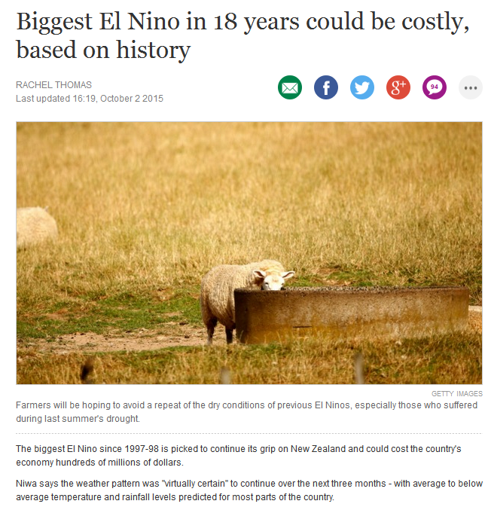

Slide 3
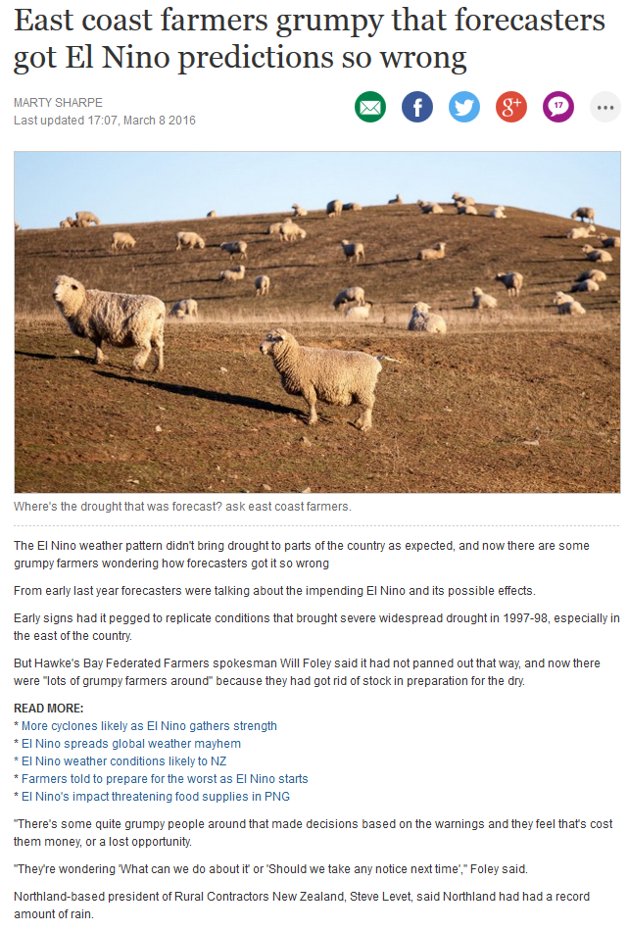

Slide 4
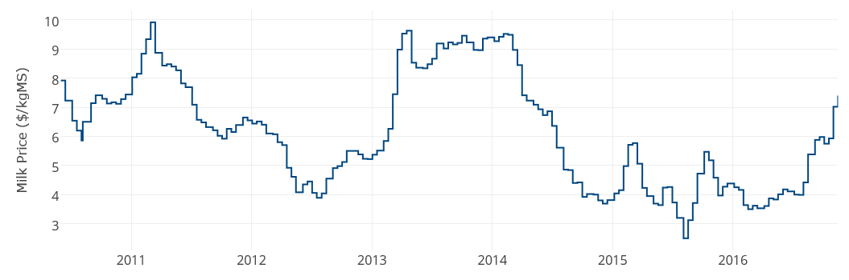
Price is Volatile
dairyanalytics.co.nz

Slide 5
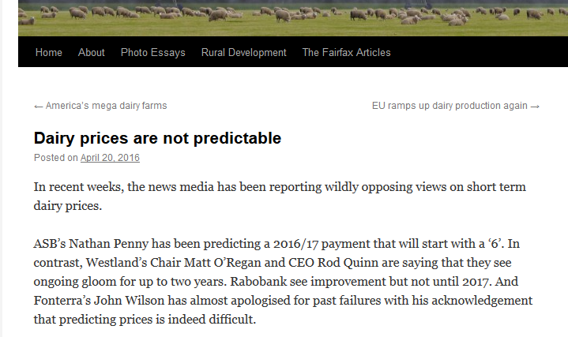
Price is Volatile
keithwoodford.wordpress.com
dairyanalytics.co.nz

Slide 6
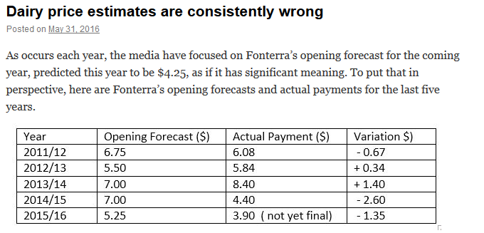
Price is Volatile
keithwoodford.wordpress.com

Slide 7
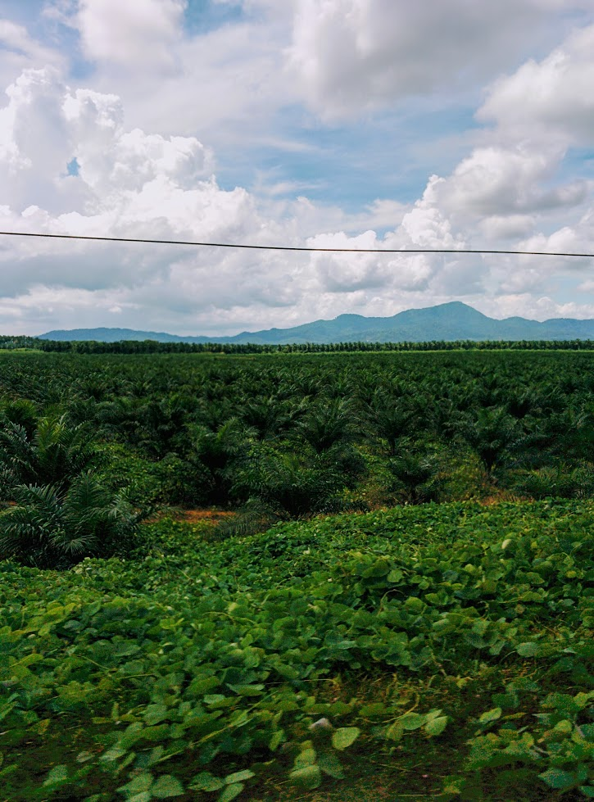
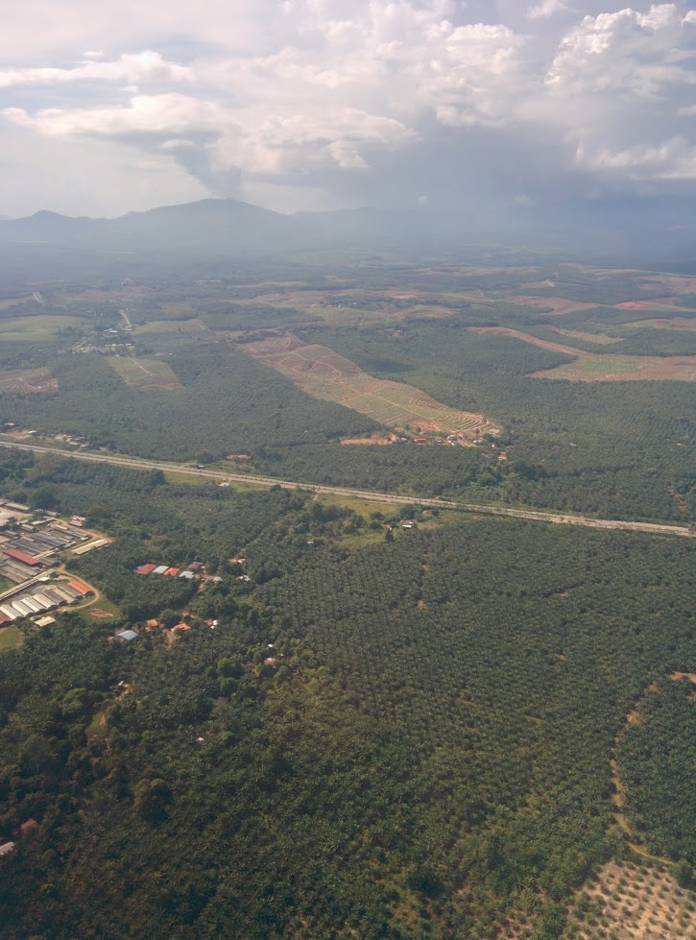

Slide 8
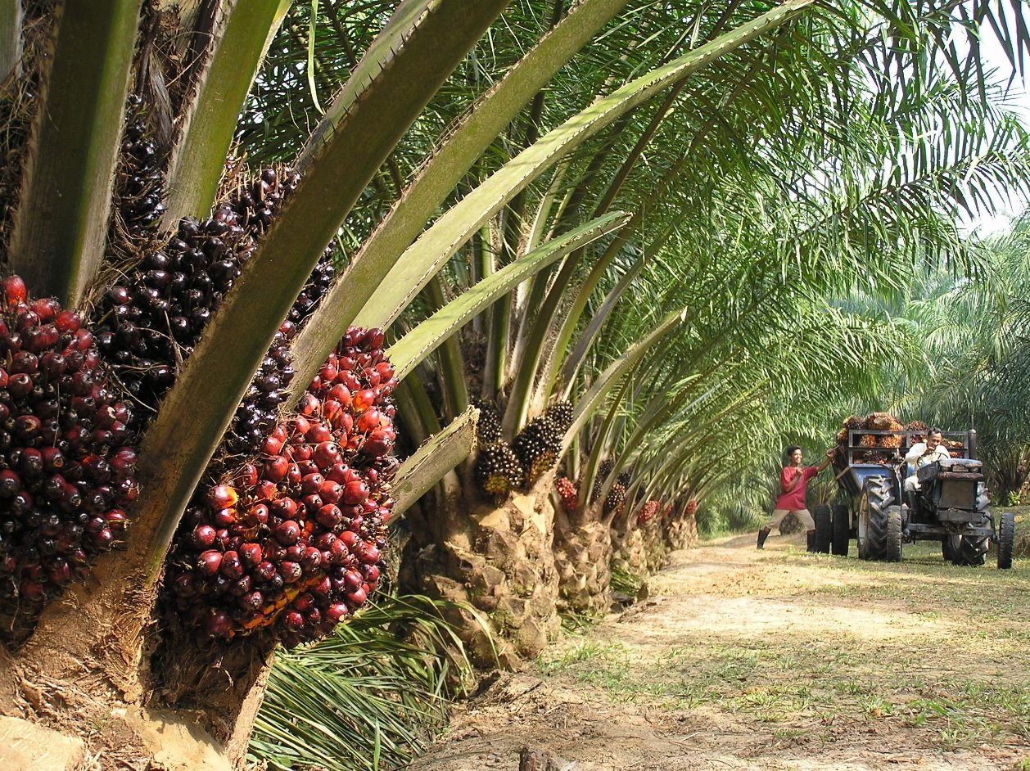
https://mylankaproperty.com/oil-palm-plantations/

Slide 9
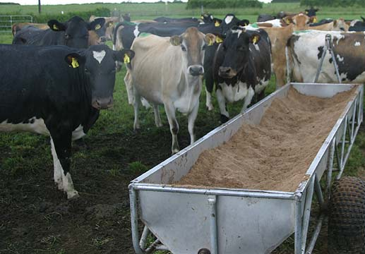
http://www.stuff.co.nz/business/farming/agribusiness/9255467/New-regime-awaits-palm-kernel-imports

Slide 10
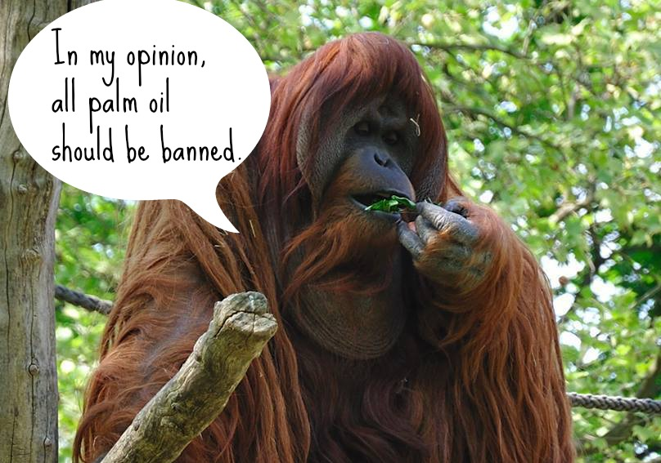
http://www.onegreenplanet.org/animalsandnature/outstanding-organizations-working-to-save-endangered-orangutans/

Slide 11
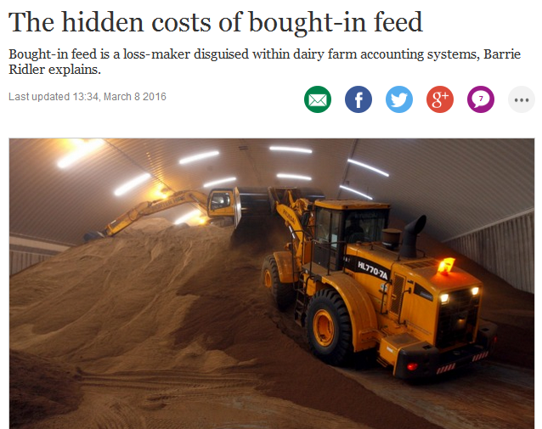
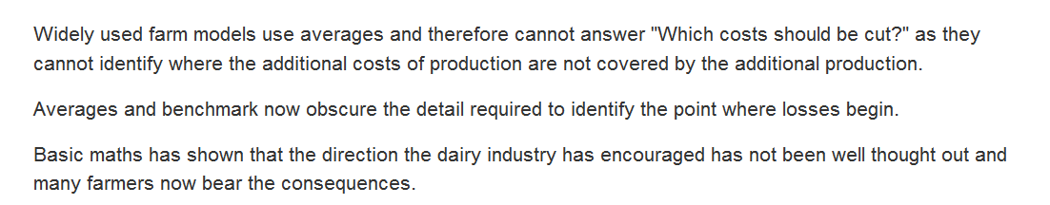

Slide 12
Stochastic Dual Dynamic Programming to the rescue!

Slide 13

Evaporation
Rainfall
Sunlight
Transpiration
Evaporation
potential
Temperature
Drainage

Slide 14
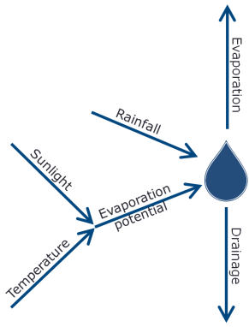

Growth
Fertiliser
Harvest
Transpiration
Feed
Nitrogen

Slide 15

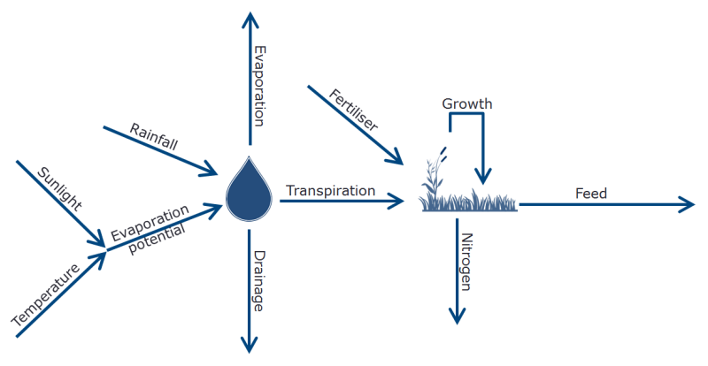
Buy
Harvest
Feed

Slide 16
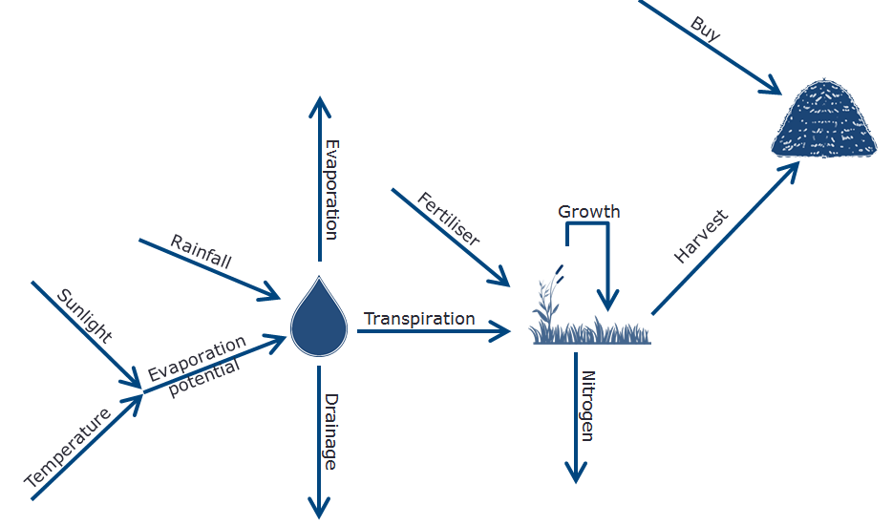

Feed
Feed
Feed
Feed
Dry
Milk
$
FGMP

Slide 17
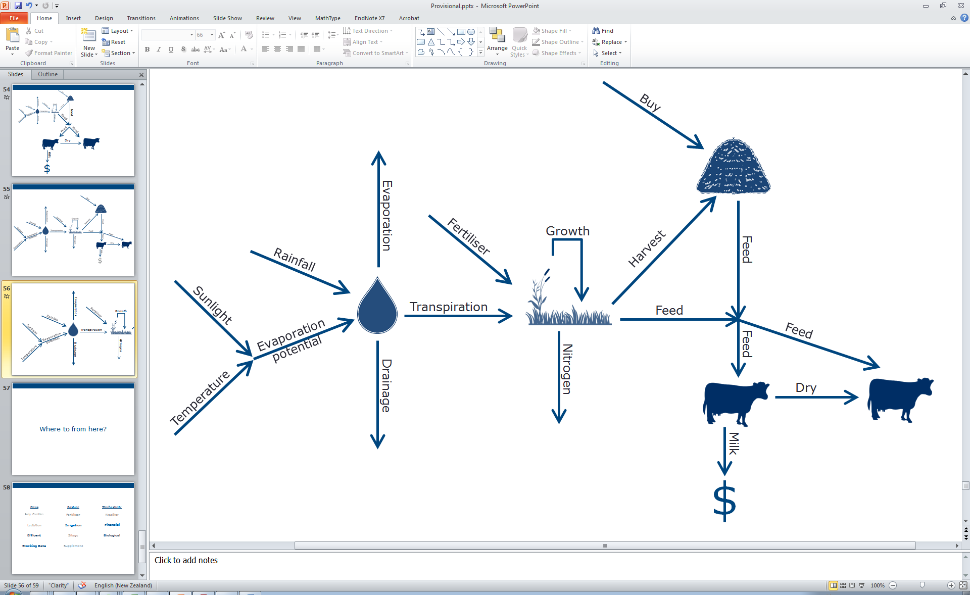
FGMP

Slide 18
An illustrative example
A farm in the Bay of Plenty
Historical Weather from NIWA
Supplement $300/Tonne DM rising to $600/Tonne (ingested)
Stocking Rate 3.5 Cows/Ha

Slide 19
Solution
Solve as a Stochastic Dual Dynamic Program
Simulate the policy lots of different times
Risk Neutral Farmer vs Risk Averse Farmer

Slide 20
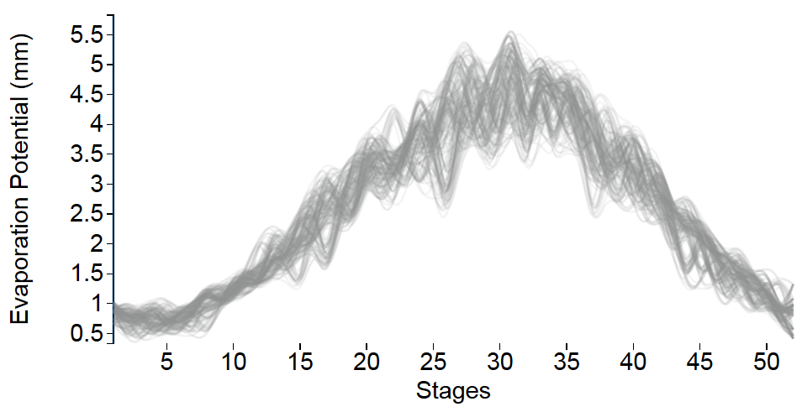
Evaporation Potential

Slide 21
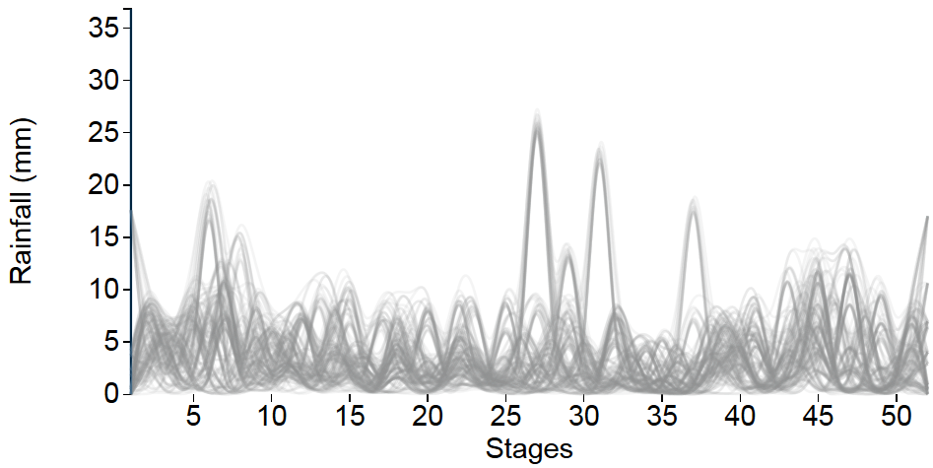
Rainfall

Slide 22
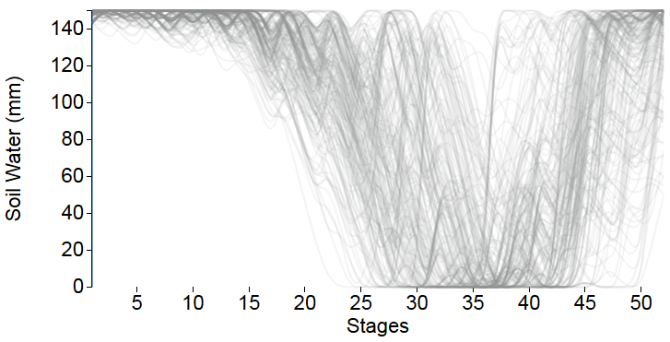
Soil Moisture

Slide 23
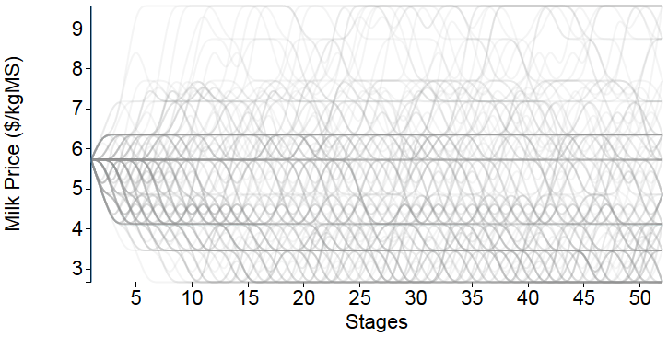
Milk Price
$

Slide 24
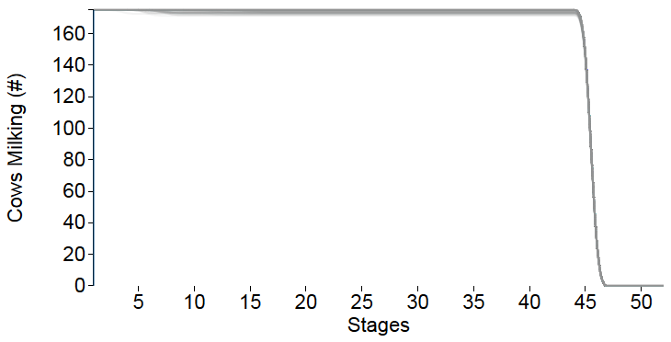
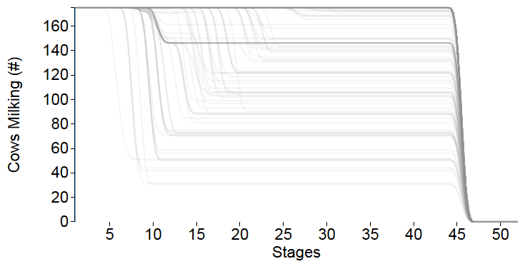
Dry off Decisions
Risk Neutral
Risk Averse

Slide 25
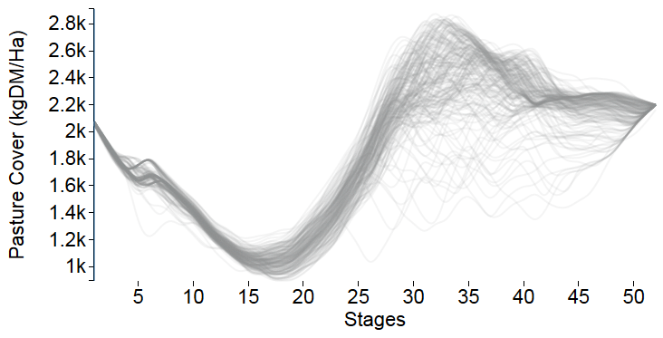
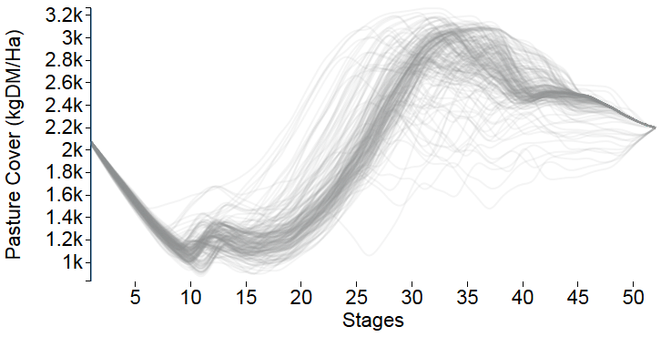
Pasture Management
Risk Neutral
Risk Averse

Slide 26
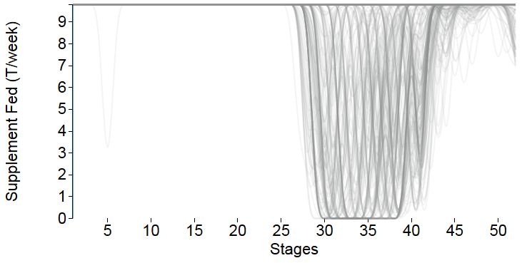
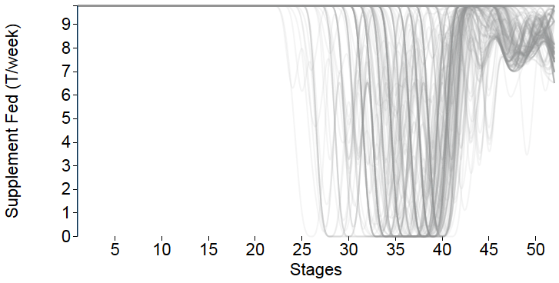
Supplementation
Risk Neutral
Risk Averse

Slide 27
Objective
Drying off cows early
Buying expensive
feed

Slide 28
Conclusions
We created a whole-farm stochastic optimisation model
It incorporates weather as a dynamical system
Management decisions depend on the risk appetite of the farmer

Slide 29
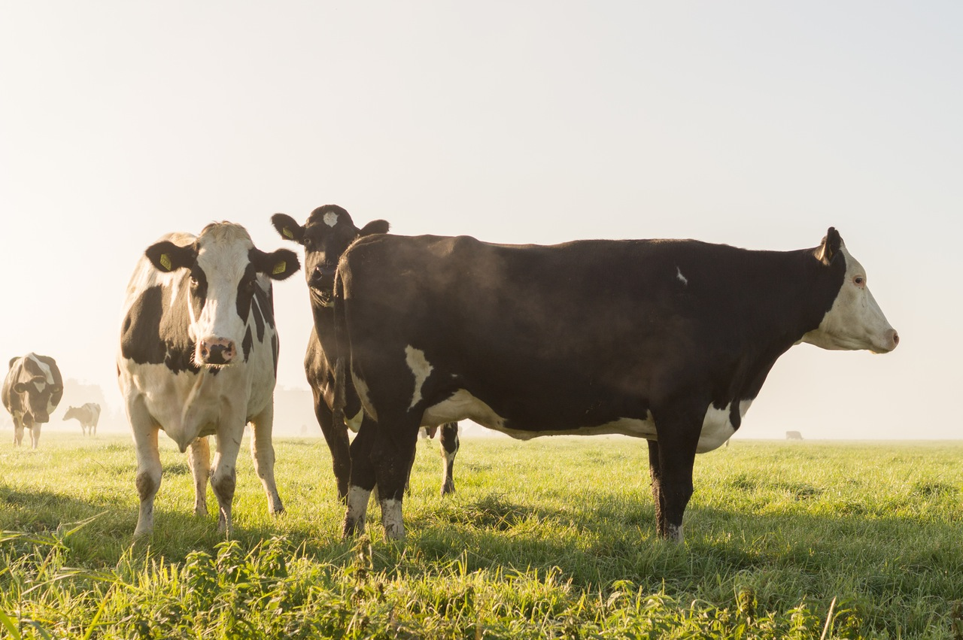
Questions

Slide 30
Help! An electricity related market design problem
Producers
Creates a random quantity of milk over time
Perishable product so all milk must be sold
Can store some as inventory
Can change product mix
Buyers
Have demand for different products
Want flexibility in contracting decisions
Can shift demand between time periods
What is the “fair market price” for the milk?
Producer
Large
Buyer
Small Buyer

